Slide 1


Green Tracks Manifesting Eco-Friendly Paths
Team-12

Slide 2
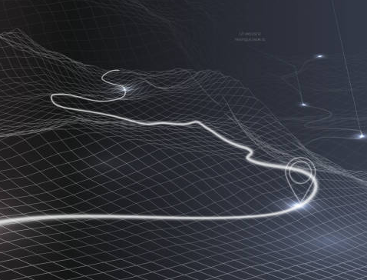


Agenda
Scope of POC
Overview of implementation
Weighted Graph Network
Custom weight metrics
Algorithm
Results
Summary

Slide 3

Scope of POC
Customer Requirements

Slide 4
Scope of POC: Problem statement
We are creating better paths for people who exercise or cycle, as they are more effected by air pollution on street.
Create a system enabling cyclists to choose safer routes, enjoy recreational options, and detect inappropriate behavior.

Slide 5
Overview of Implementation
AQI Data
Incivility Data
Map Data
Source & Destination
Weighted Graph Network
Djikstra Algorithm
Optimized path

Slide 6

Weighted Graph Network
A weighted graph or a network is a graph in which a number (the weight) is assigned to each edge. Such weights might represent for example costs, lengths or capacities, depending on the problem at hand.
With the help of Open Street Map (OSM) API, we are creating a weighted graph network which uses weights in term of AQI score, incivility score and distance. This weighted graph network is then used to find the best possible route between the source and destination.

Slide 7
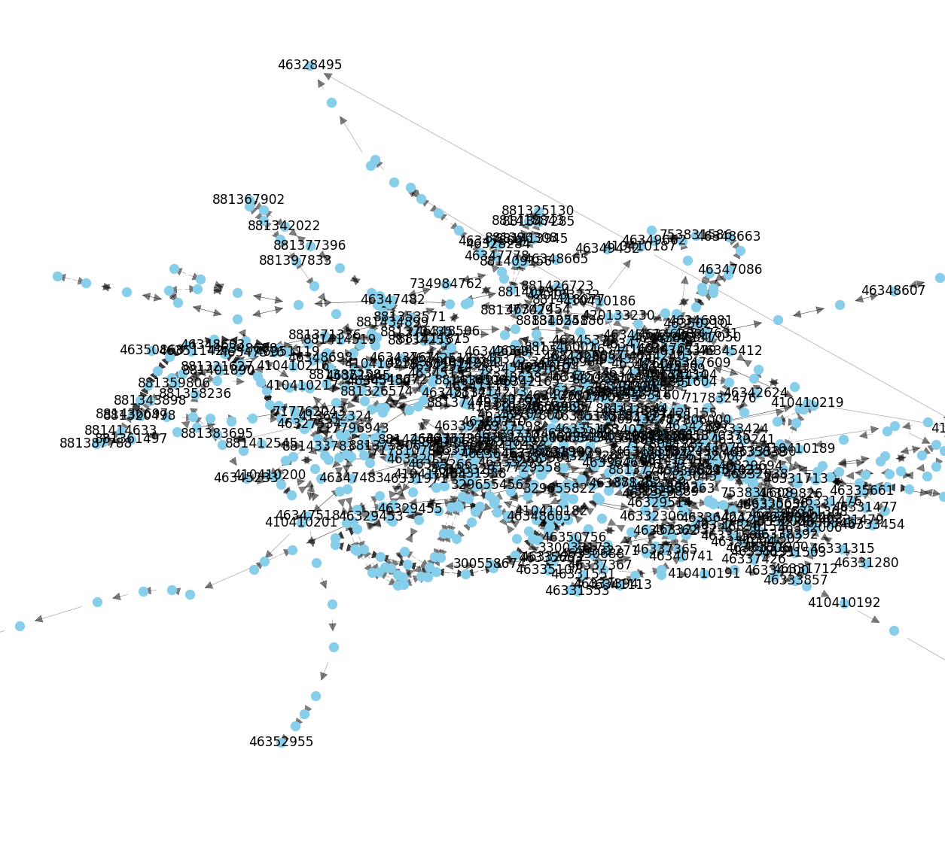
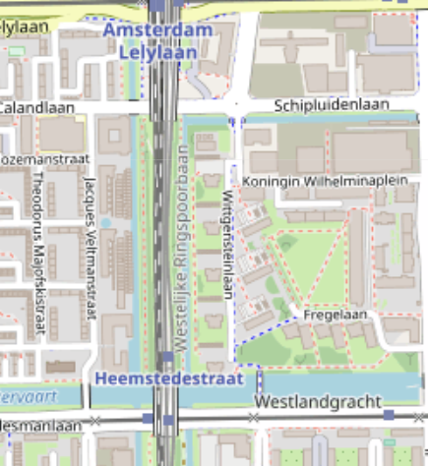
OSM Graph Visualization

Slide 8
Custom Weights used in Graph
Distance between source and target
AQI score of each street or avg of neighborhood
Incivility Data - Harmonic mean of security and cleanliness score

Slide 9


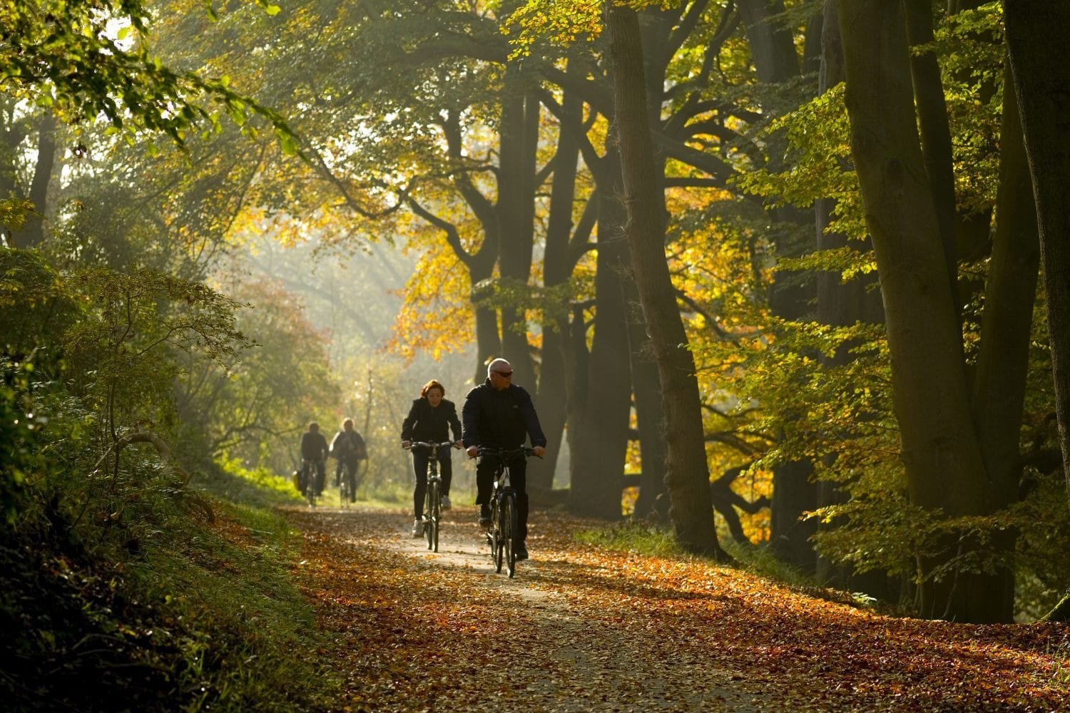
Algorithm
Importing Libraries: osmnx, networkx, folium, and pickle.
File Path and Graph Creation using Start and End coordinate Selection.
Using Weight Definition from different source to create graph network.
Shortest Path Calculation (Dijkstra's algorithm) : considers the edge weights based on AQI and safety scores.
Coordinates Retrieval for Map Creation(Folium object)

Slide 10
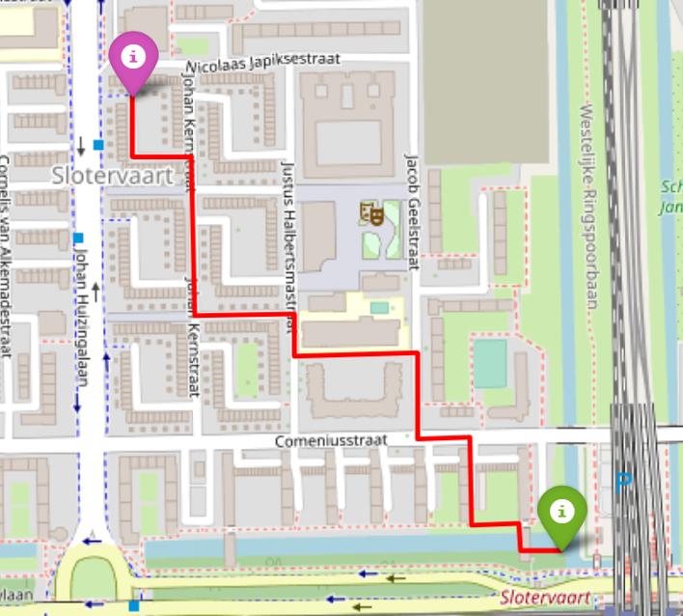
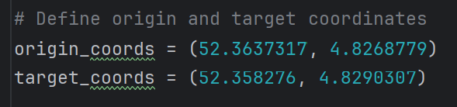
The results
For below coordinates the out on right was generated.
Although there were other path the algorithm returned coordinates for the one with best AQI and Incivility score.

Slide 11


Summary
By factoring in the Air Quality Index (AQI) and optimizing the route to minimize discomfort during the journey, we're not just suggesting a path for cyclists; we're crafting a personalized, refreshing journey that puts their well-being and environmental awareness at the forefront.

Slide 12

Thank you
Team 12

